Slide 1



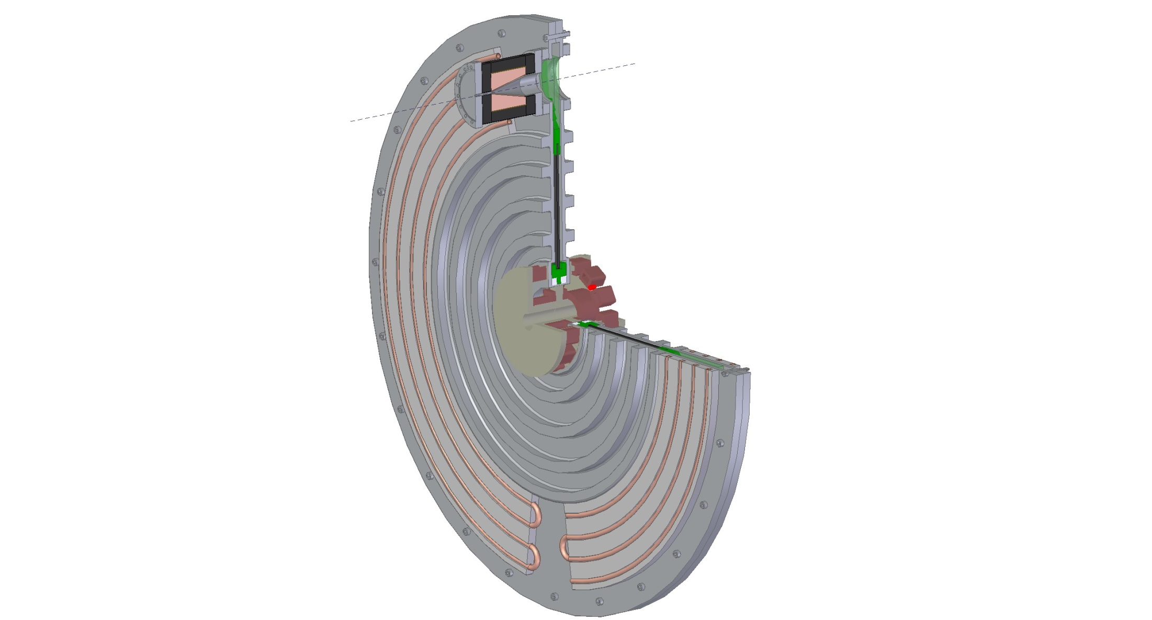
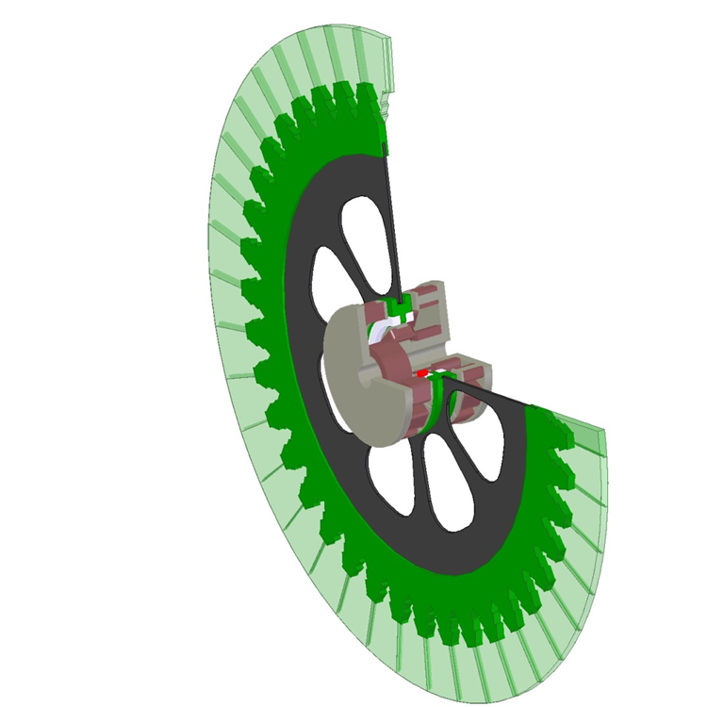
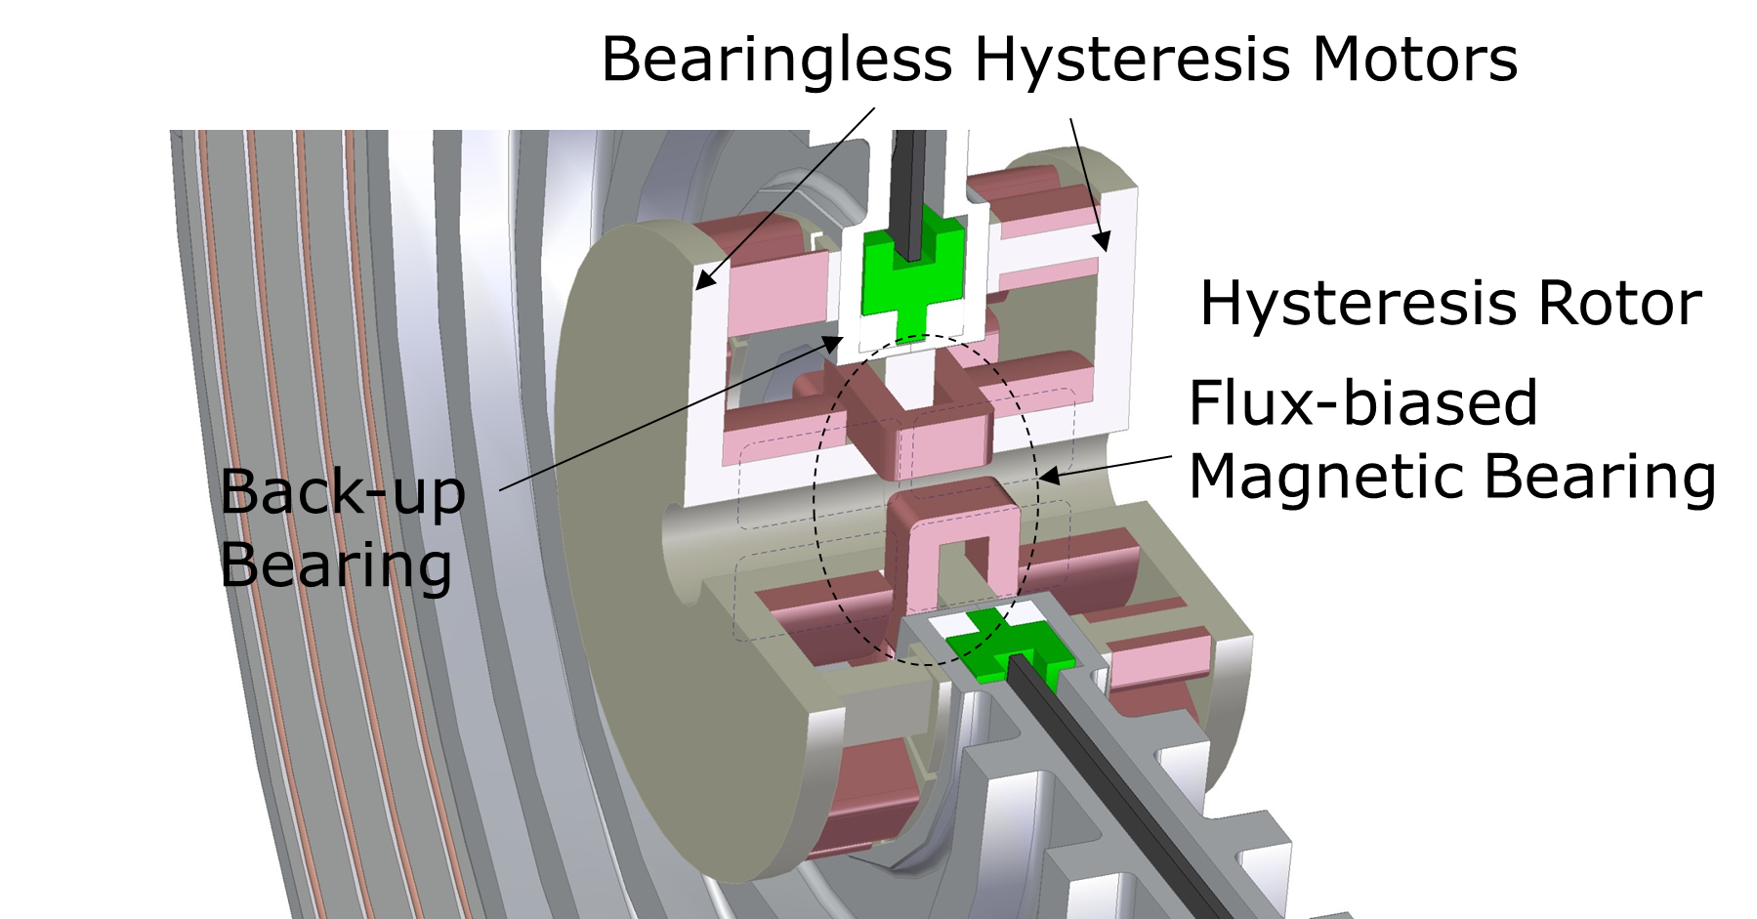
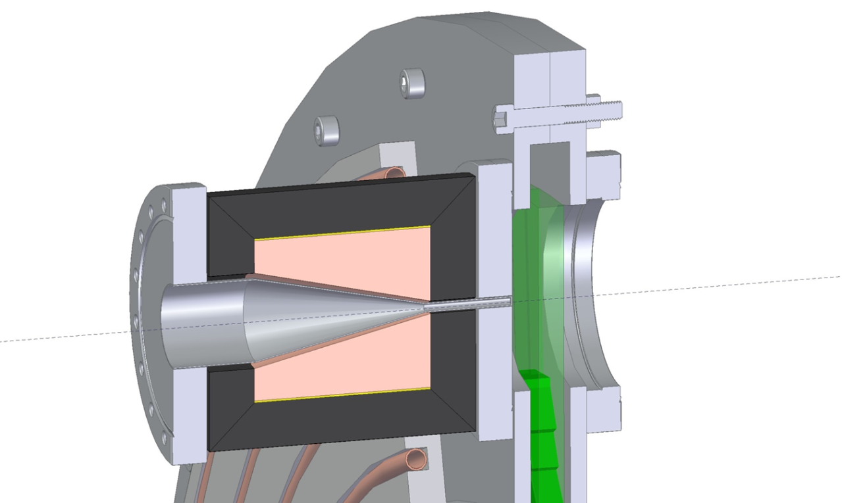
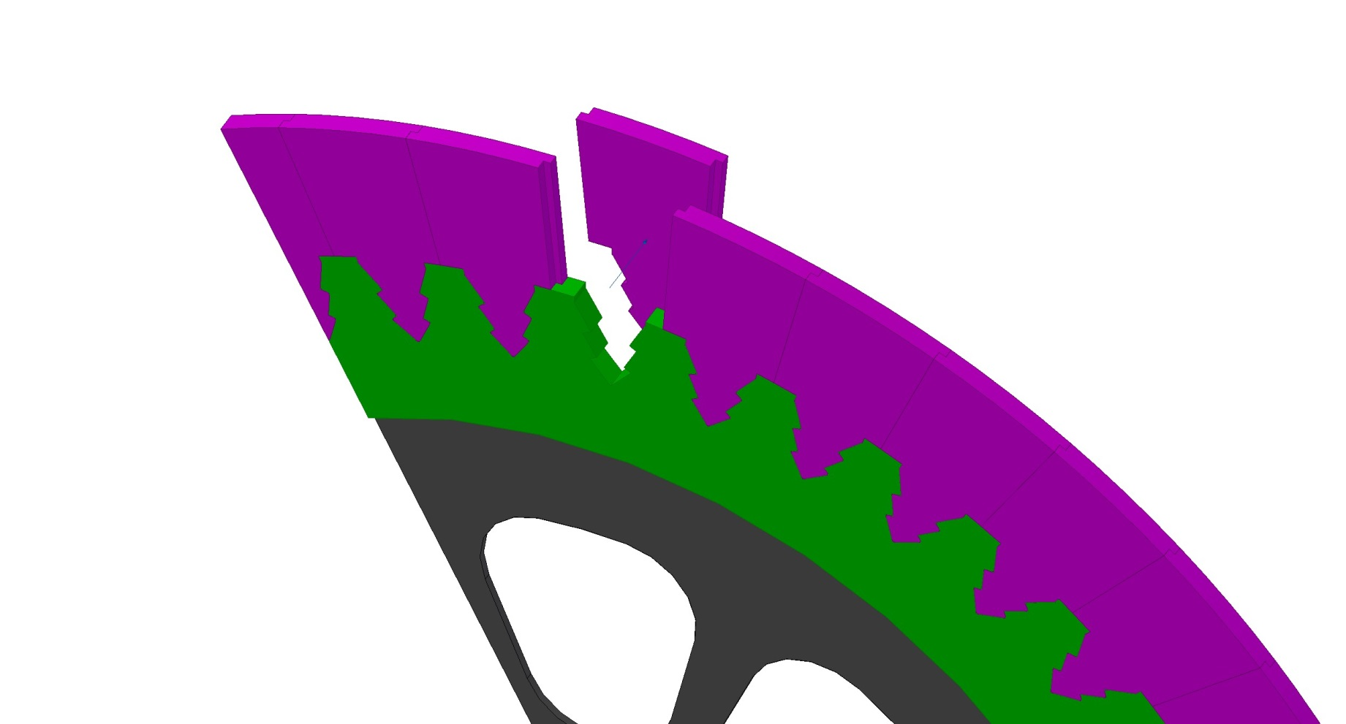
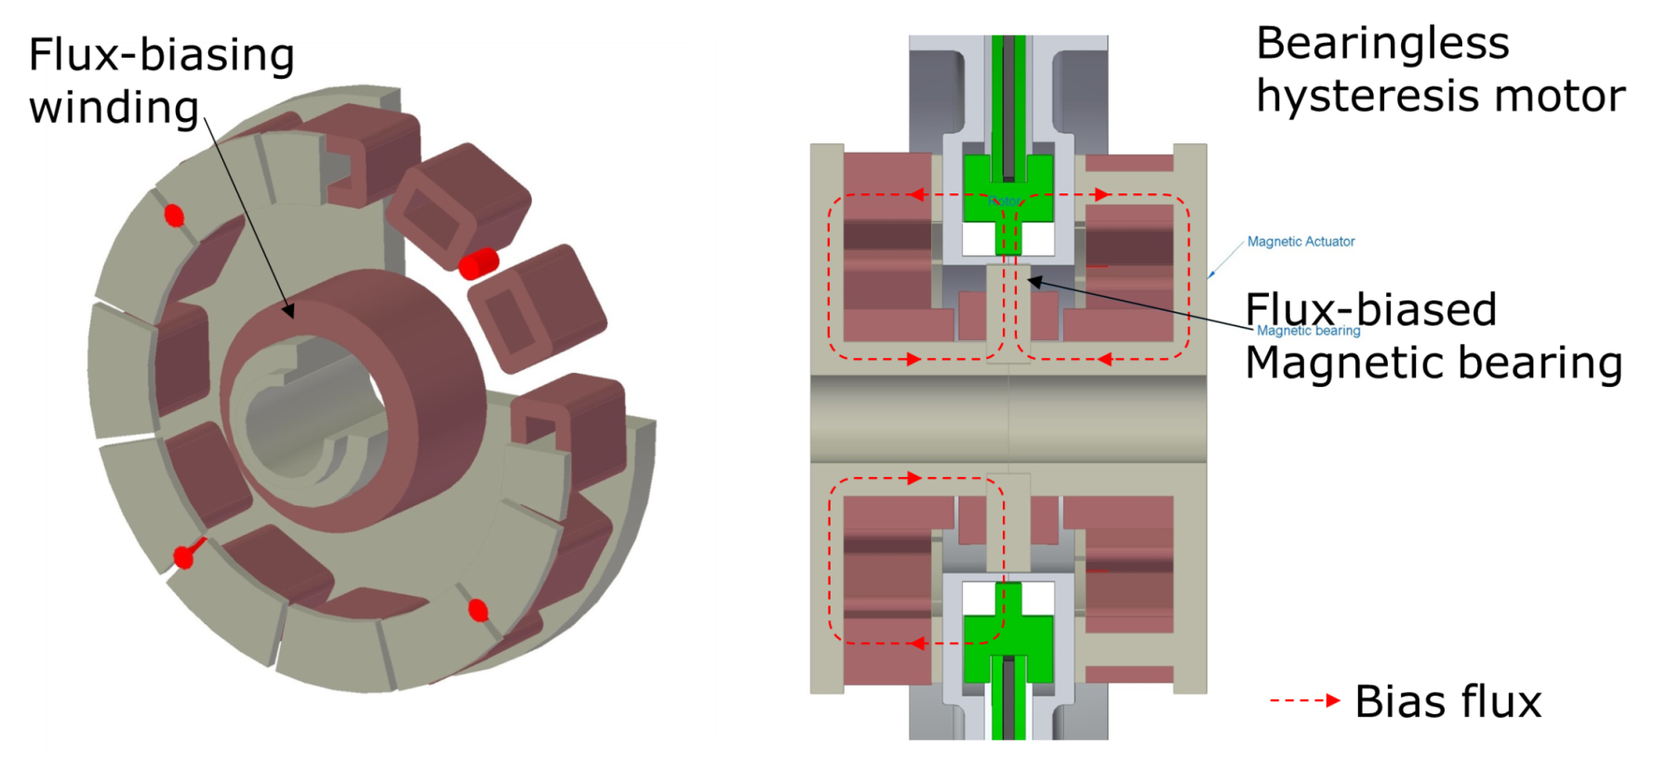
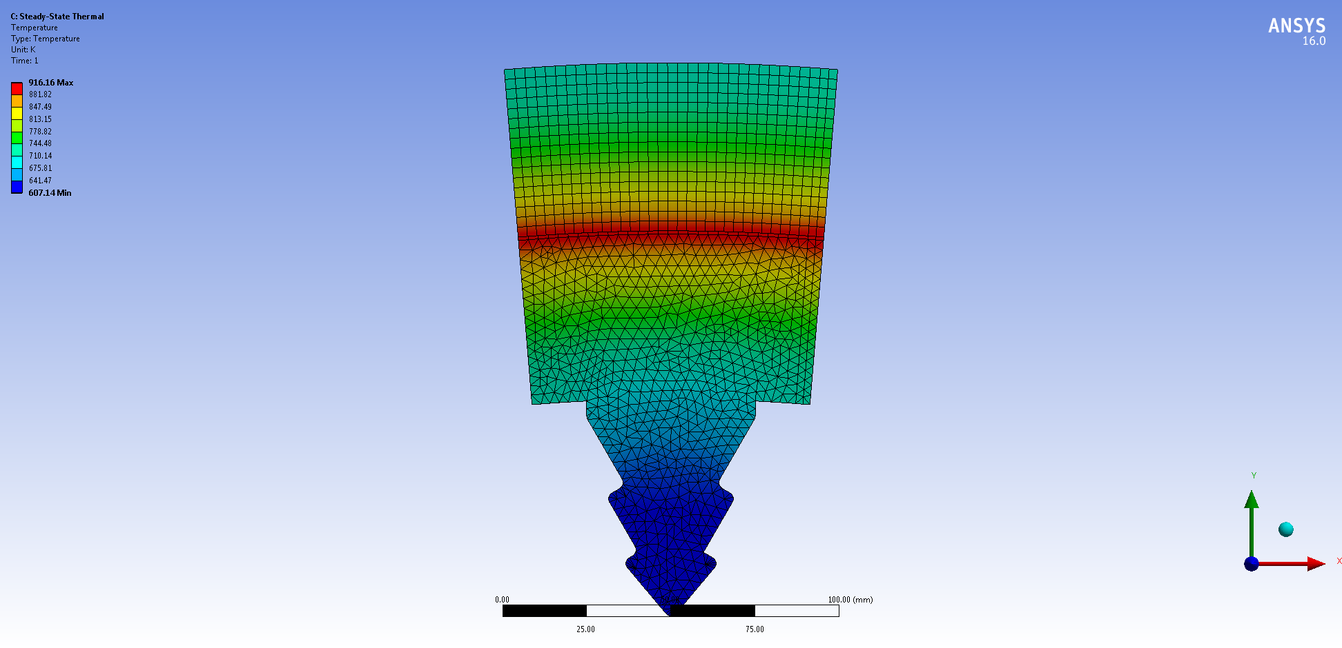
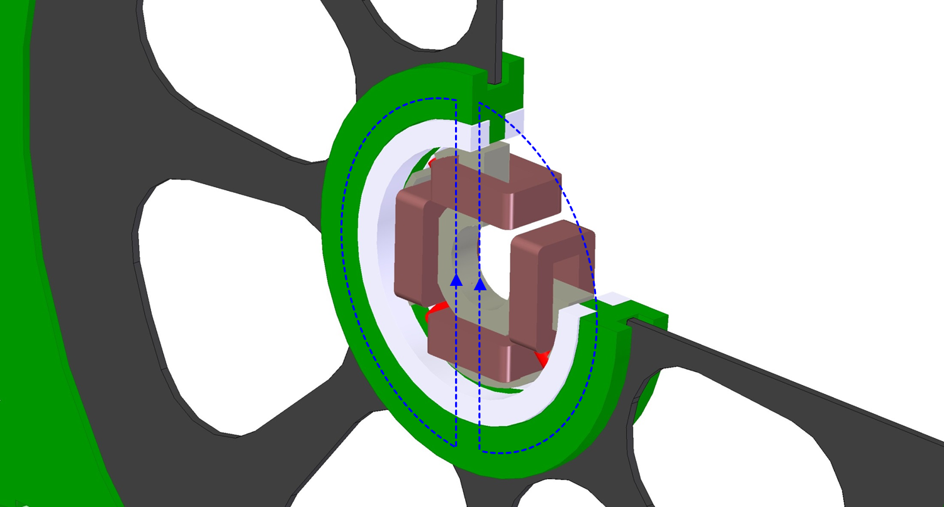
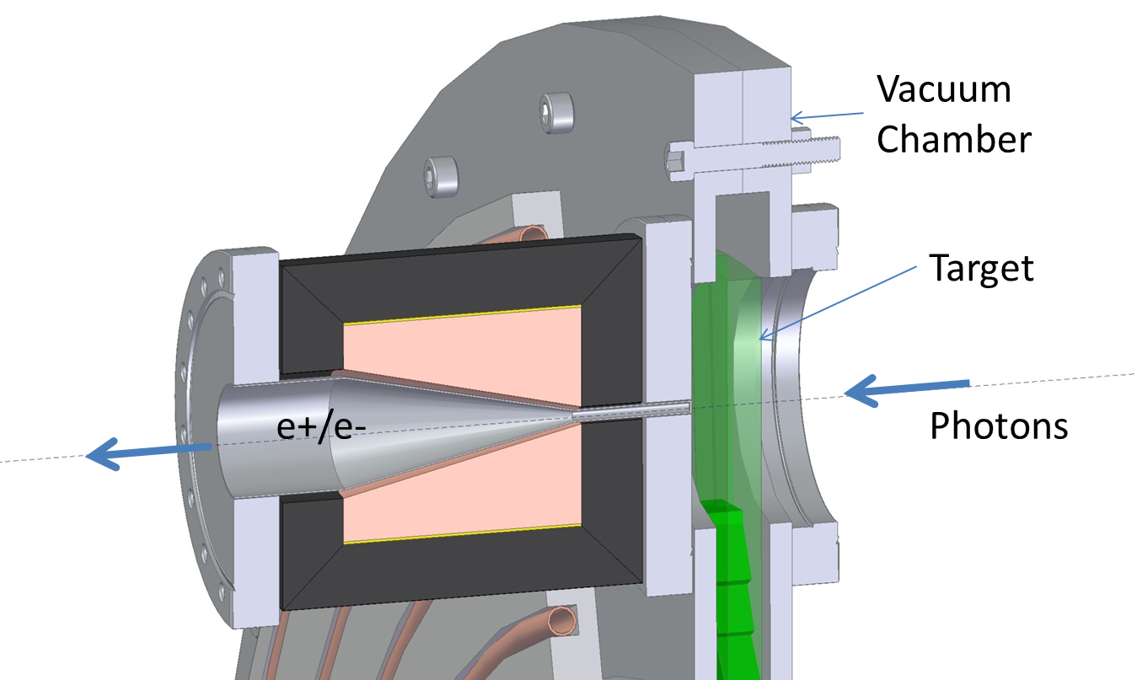
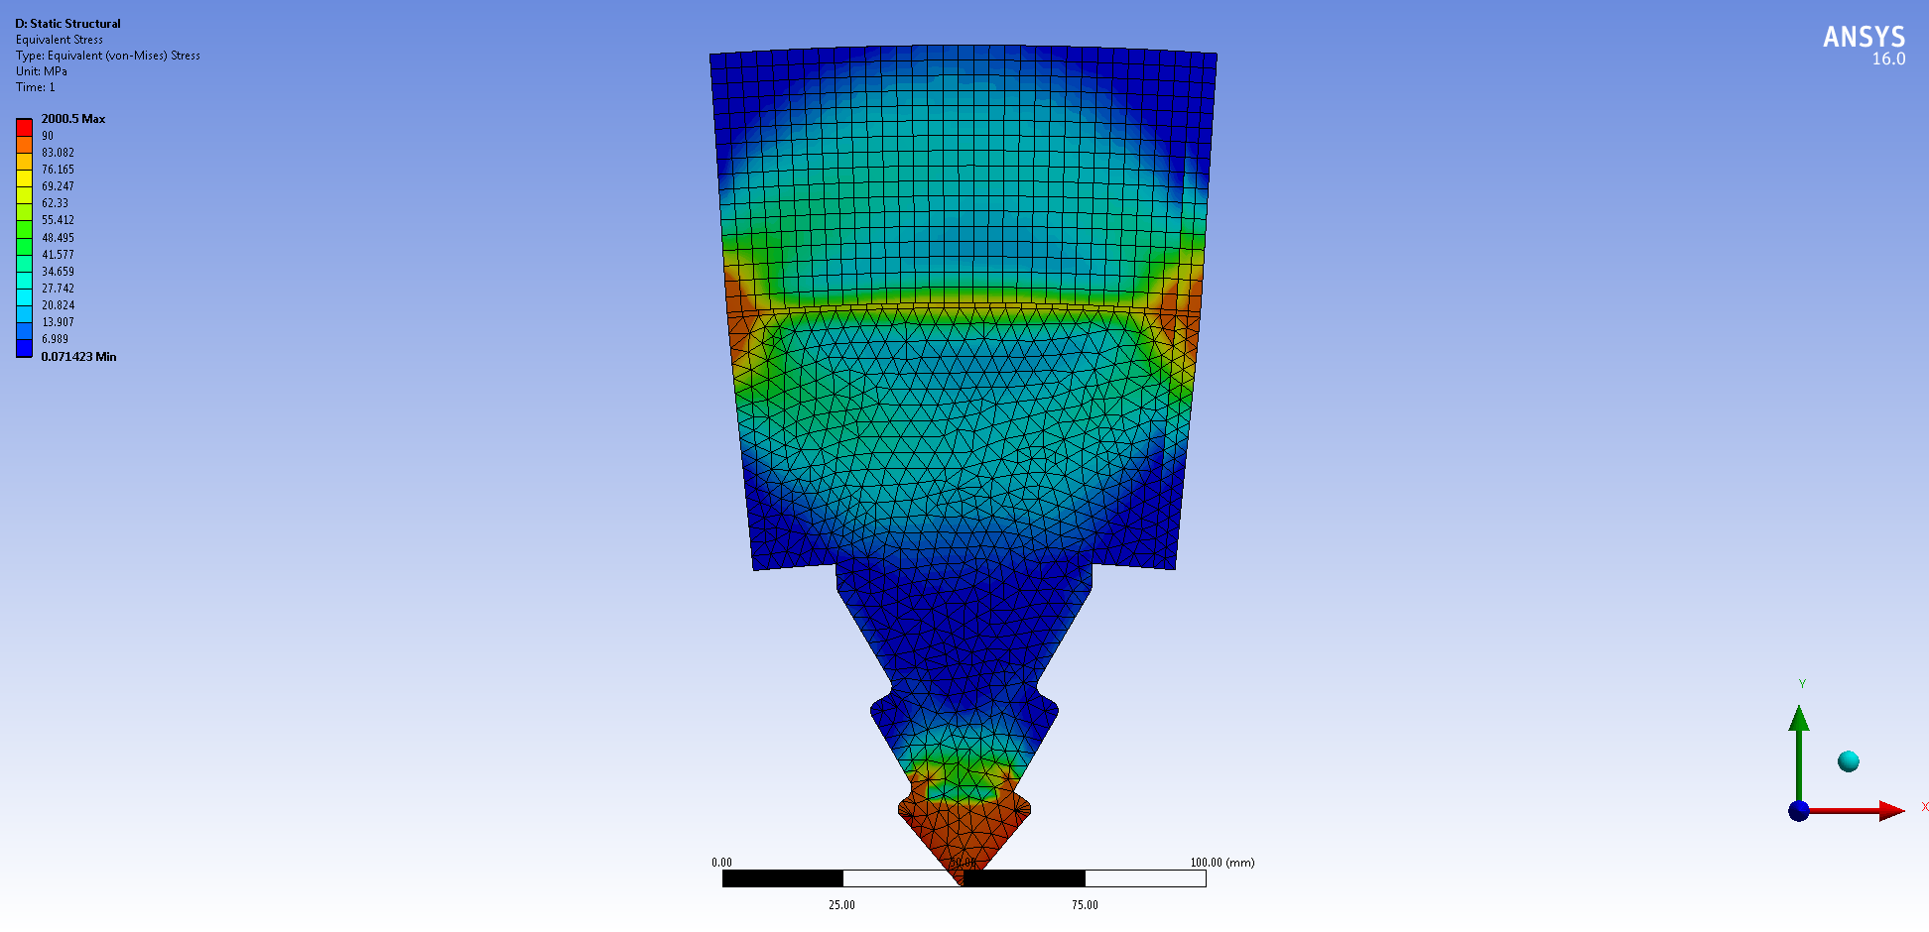
A Positron Target Concept for the ILC
M. Breidenbach¹, M. Noh², M. Oriunno¹, J.C. Sheppard¹, D. Trumper²
¹SLAC ²MIT
Introduction
The magnetic drive/suspension system has two bearingless hysteresis motors and a flux-biased magnetic bearing. Bearingless hysteresis motors actively control/stabilize two tilts and axial translation. Also, they generate a hysteresis torque to drive the target wheel. A flux-biased magnetic bearing at the center generates radial forces for active suspension.
The ILC Optical matching device (OMD) is a normal-conducting pulsed flux concentrator designed and prototyped by LLNL. The magnetic field of the OMD interacts with the spinning metal of the target to create Eddy currents. Target designs must take into account this drag force which produces an increased average heat load, requires a stronger drive motor and possibly causes 5 Hz resonance effects. An iron flux return yoke is being considered to reduce the flux on the target. However, scaling from numerical simulations of a spinning target in a dc field (Antipov et al, J. Appl. Phys. 102, 014910 ,2007) indicates that the iron yoke may not be required.
The ILC polarized positron source design is based on a polarized photon beam striking a 14 mm Ti target. Because both the instantaneous and average power are high, the concept of a rotating Ti hoop in the accelerator vacuum is accepted. The TDR baseline uses water cooling introduced through rotating seals, and rotating seals are used for an axial drive shaft. We are developing a concept using radiation cooling of high performance Ti alloy blades to a water cooled vacuum can, completely eliminating water channels in the vacuum space. In addition, we are developing a concept for magnetic suspension and drive of the hoop, eliminating shaft seals, that does not require permanent magnets, and so should survive in the high radiation field of the target.
The hoop must rotate at ~2000 rpm, and thus Eddy current drag from the focusing elements are important.
Magnetic Drive and Suspension
Rotating Target Wheel ~2000 RPM
Ti Target Blades 14 mm thick Ti-SF61
Bearingless hysteresis motor has a bottom plate, stator teeth projecting from the plate, a flux-biasing column at the center, and stator windings. The winding around the flux-biasing column generates a bias flux (red dashed lines). The windings around the stator teeth superpose two-pole suspension flux on the bias flux for bearing force generation. They also generate a six-pole rotating motor flux for torque generation.
Temperature [K]
Max. 916 K
Conclusions
This target concept addresses the issues of rotating seals in UHV by radiation cooling the actual target and magnetically suspending and driving the target wheel by a system without permanent magnets. Eddy current drag forces on the wheel are reconsidered and appear reasonable for the magnetic drive.
The drive system is ~ready for prototyping.
Target Concept
Flux Concentrator
Stress VM [MPa]
Max. 100 MPa
Flux-biased magnetic bearing comprises a four-tooth stator and two pairs of windings. Each pair of windings generates a two-pole magnetic flux (blue dashed lines), which strengthen the bias flux on one side of the rotor and weakens it on the other side, thereby generating a reluctance force for active suspension.
Acknowledgments
We would like to acknowledge helpful conversations with S. Riemann, P. Sievers, A. Ushakov, and F. Dietrich.

