Slide 1
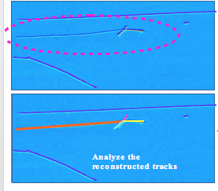
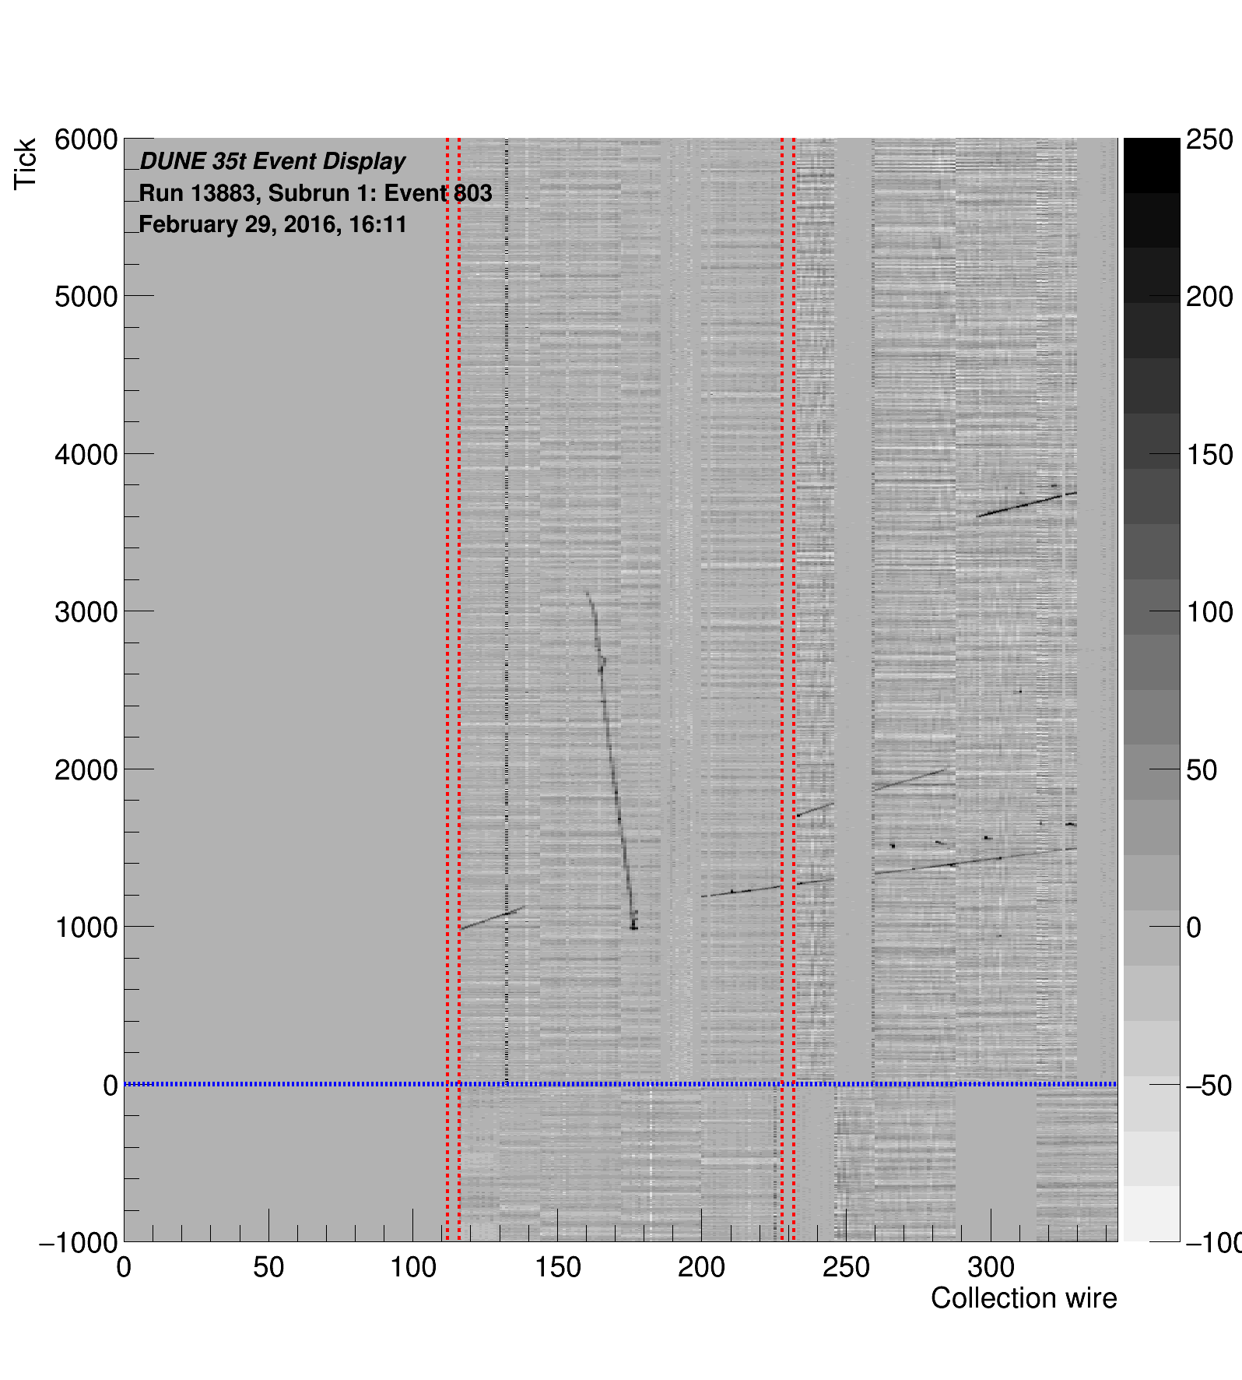
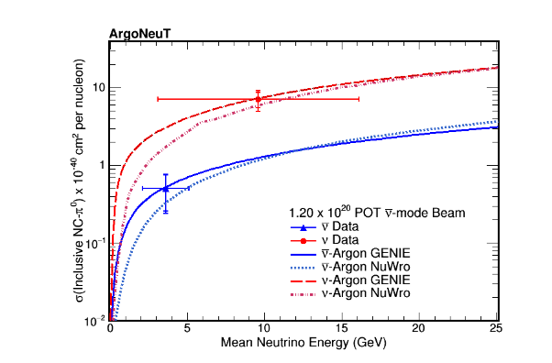
Courtesy MicroBooNE collaboration http://www-microboone.fnal.gov/publications/publicnotes/MICROBOONE-NOTE-1010-PUB.pdf,
Courtesy LArIAT Collaboration π - Ar Event Selection, FNAL Wine and Cheese Seminar
Courtesy DUNE Collaboration http://lbne-dqm.fnal.gov/ArchiveEventDisplay/ArchiveEVD_xaa.html
Courtesy ArgoNeuT Collaboration: http://arxiv.org/pdf/1511.00941.pdf

